Slide 1
Detente
From the French se detendre….
To Relax

Slide 2

What is it?
Describes a relaxing of tensions between the Cold War Superpowers
Involves international relations on a number of levels
  Arms Race
  E. Europe
  China/USSR/US

Slide 3
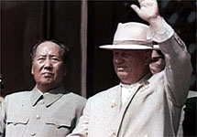
Why?….
In part due to Sino-Soviet tension of early 1960’s
Russia has mass build-up of troops along Russo-Sino border 1969
Chinese fear nuke attack(pic is Mao & Khrush just before split)
In part a result of economic potential
Clear break from monolithic communism

Slide 4
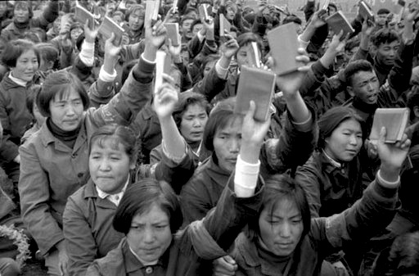
When did it start? Détente 63-68
US-China relations hostile
Cultural Revolution
Nuclear Development
Modest aid to N. Vietnam
Sino-Soviet Split

Slide 5
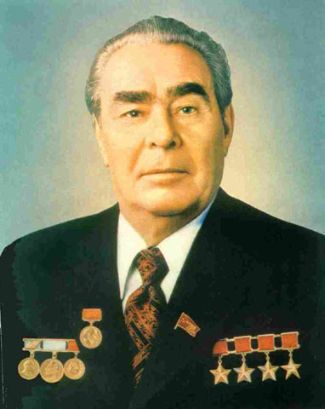
Would you call this Détente?
63-68 USSR-US
Johnson claims significant agreements
USSR Aid to N. Vietnam after 1965
NPT Treaty 1968
Start of SALT talks
USSR arms increasing quantitatively
Brezhnev cautious about giving up too much to US

Slide 6

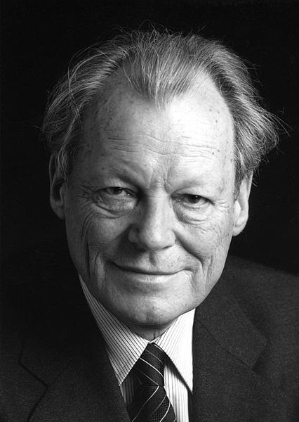
Rapprochement: European Détente after 1968
Europe has its own Détente w/ USSR
Ostpolitik – German move to “look east”
US worried about possible derailment of US goals, but goals end up correlating
Controversial: Willy Brandt (FRG) looses some domestic support for this

Slide 7

Ostpolitik & 2 Germanies
Hallstein Doctrine had prevented recognition of E. Germany (GDR)
Brandt’s moves allow defacto recognition of GDR – thus other agreements could be entertained
Allows for unification as a long-term goal (as opposed to short term)

Slide 8
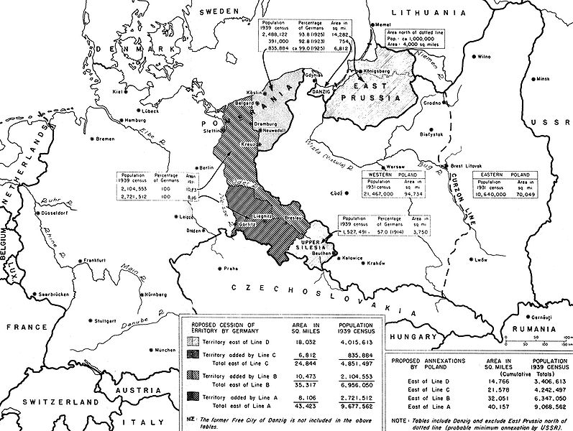

Treaty of Moscow 1970
FRG & USSR
Recognizes Oder-Neisse Line (Poland/E. Germany – gives part of historical E. Germany to Poland)

Slide 9
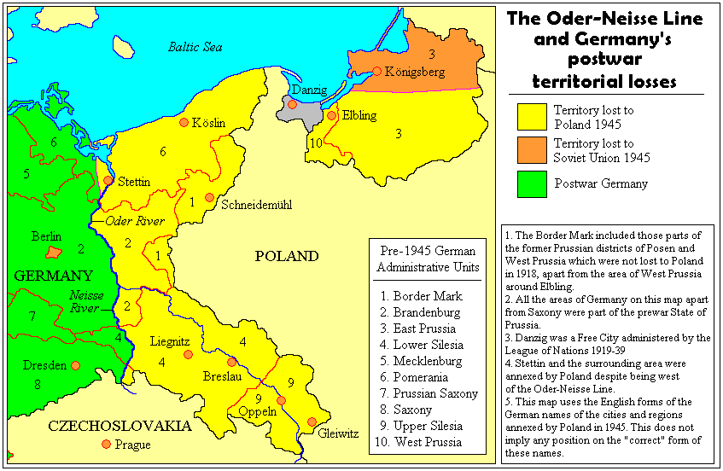

Slide 10
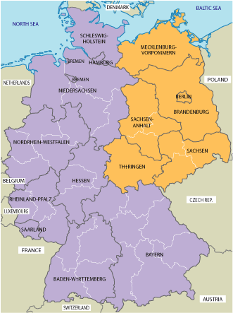
Basic Treaty of 1972
Between FRG & GDR
Recognized two states (but one nation)
Increased cultural, commercial & personal relations
Both subsequently entered into the UN as separate nations

Slide 11
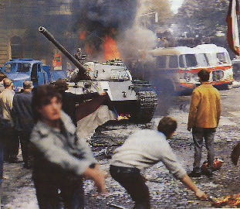
US Policy toward E. Europe
Change from liberation to building bridges
What does this mean for Czechoslovakia?
Read Walsh pages on Prague Spring – What is the Brezhnev Doctrine?
Do you agree with Levering that this is a sign of détente? Explain

Slide 12
Nixon-Kissinger Foreign Policy
Peace through balance of power
Chief power (US) gives rivals a reason & stake in improved relations
Balancer throws weight around to keep balance
Don’t specify friends & enemies
Baby steps – we’re not desperate for détente (or anything else)
US
USSR
China
W. Europe
Japan

Slide 13
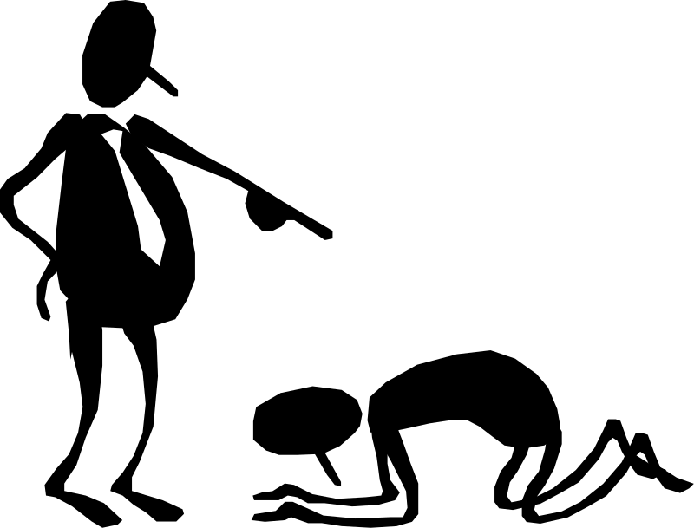
Triangular Diplomacy – US perspective
Allows US to play USSR & China off of each other
US sees China as a tool for pushing USSR to accept terms of arms control & détente in Europe & Vietnam
Chance of renewing a slowing economy

Slide 14
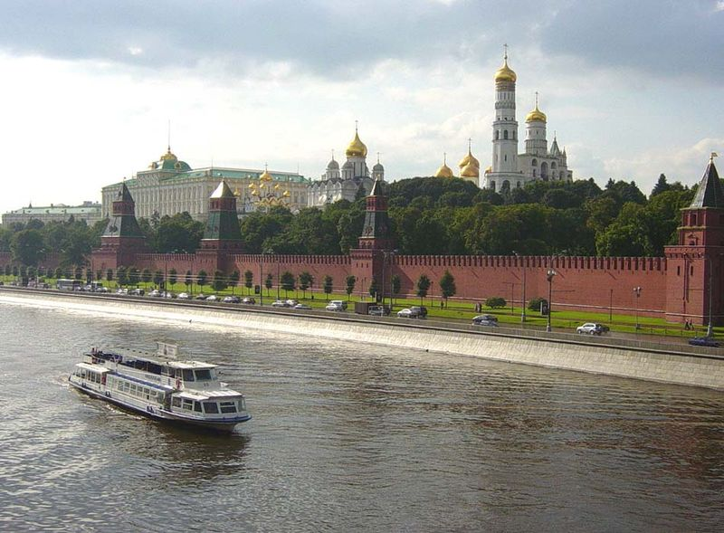
Détente w/ US – USSR perspective
Need to avoid nuclear conflict (US also) – Prague, 6-Day War, Vietnam remain limited
Russia needs grain deal from US – MFN status received by Russia
Increased prestige for Brezhnev
Protection from China
Détente w/ US Eases détente w/ FRG

Slide 15
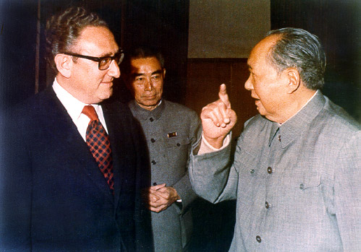
Détente w/ US – China’s perspective
Sees promise of disengagement from Indochina
Allows for concentration of forces on N. Border w/ USSR
Trade opportunities w/ US (better than stagnant trade w/ USSR)

Slide 16
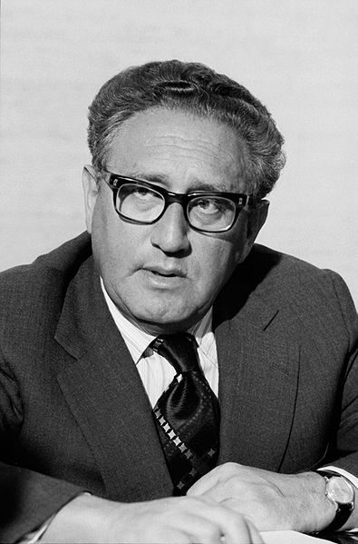
Evidence of Détente w/ China
Relaxation of travel & trade restrictions (some)
Increased communication – Nixon refers to China as “The People’s Republic of China)
1971 US Ping Pong team visits China
1971 Nixon cancels trade embargo
US does not block the UN’s move to make
PRC part of UN Security Council
US backs Pakistan (against India) in war that creates Bangladesh (12/1971) (Pak. & China friends)
Feb 1972 NIXON VISITS CHINA!
Kissinger makes secret trips to China

Slide 17

Shanghai Communique
Feb. 28 1972
Read the communique
What are the most important points that come out of the communique?
Impact on Taiwan?

Slide 18
The Moscow Summit 1972
During the week-long summit several agreements between the two countries were reached.
On 26 May SALT I was signed in the Kremlin by Nixon & Brezhnev
  SALT limited each superpower to 200 defensive nuclear missiles and froze the number of intercontinental ballistic missiles for the next five years.
Agreed to establish more favorable conditions for developing commercial and other economic ties
Agreed to make their first joint manned venture into space in June 1975
Other agreements relating to incidents at sea, science and technology, health and the environment were also made

Slide 19
Helsinki Accords 1975
The Act's "Declaration on Principles Guiding Relations between Participating States" (also known as "The Decalogue") enumerated the following 10 points:
I. Sovereign equality, respect for the rights inherent in sovereignty
II. Refraining from the threat or use of force
III. Inviolability of frontiers
IV. Territorial integrity of States
V. Peaceful settlement of disputes
VI. Non-intervention in internal affairs
VII. Respect for human rights and fundamental freedoms, including the freedom of thought, conscience, religion or belief
VIII. Equal rights and self-determination of peoples
IX. Co-operation among States
X. Fulfilment in good faith of obligations under international law - wiki

Slide 20
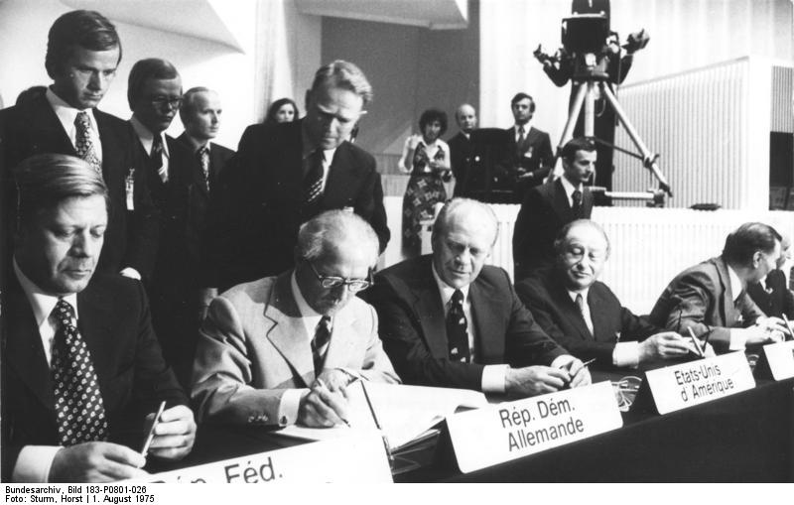
Outcomes of Helsinki
Agreements in 3 major areas – economics, security, & human rights
Resulted in Helsinki Watch Groups that kept opposition alive in the USSR
Signed by 35 countries
Seen as highlight of détente, even if ultimately ineffective

Slide 21
Gaddis….
Brezhnev had looked forward, [Anatoly] Dobrynin recalls, to the publicity he would gain…when the Soviet public learned of the final settlement of the postwar boundaries for which they had sacrificed so much…[Instead, the Helsinki Accord] gradually became a manifesto of the dissident and liberal movement’…What this meant was that the people who lived under these systems – at least the more courageous – could claim official permission to say what they thought.”
-- John Lewis Gaddis in “The Cold War: A New Cold War History” 2005

Slide 22
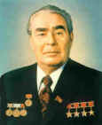
In Summary
What is Détente?
How did it impact the Cold War?
What evidence do we have that we engaged in Détente with USSR, E. Europe, & China?
What are the names and events we should remember?

